Slide 1
Pedigree Verification in Cassavas
Kyndra & Bryan

Slide 2
Pedigree Analysis Tool
Perl and R version
Assign a value of plausible or implausible
Mother: [2] Father: [2] Child: [0] = Implausible
Mother: [1] Father: [1] Child: [1] = Plausible
Identifies the amount of implausible SNPs between parent and child and divides by total SNPs to assign a conflict score
Possible Tweaks: Discount any markers with a score of 1, use a population wide filter to remove uninformative SNPs, use only whole number SNPs

Slide 3
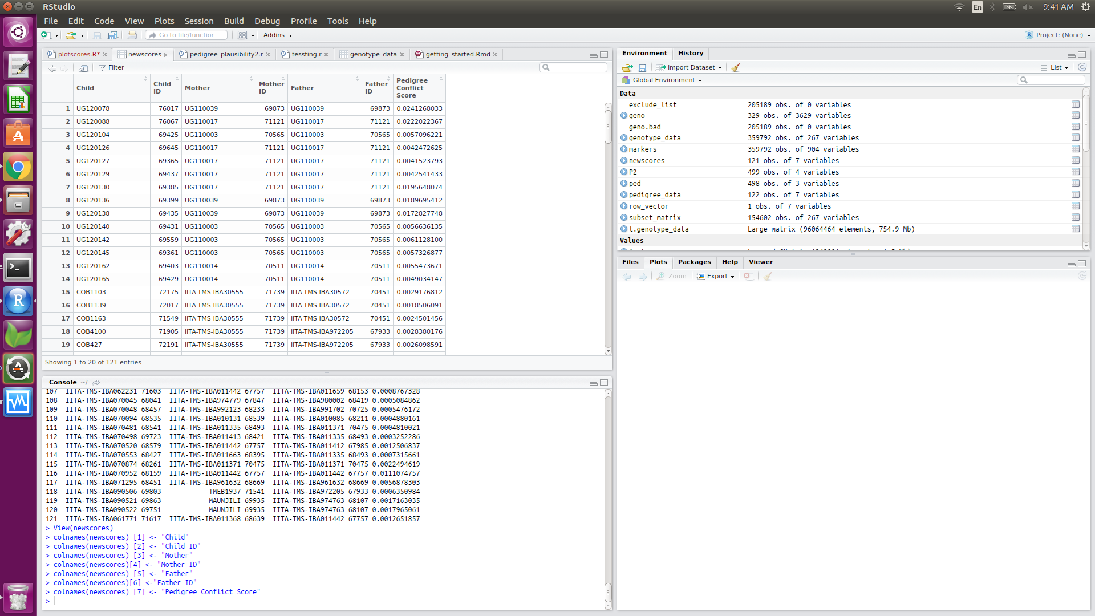
Data from Pedigree Analysis Tool

Slide 4
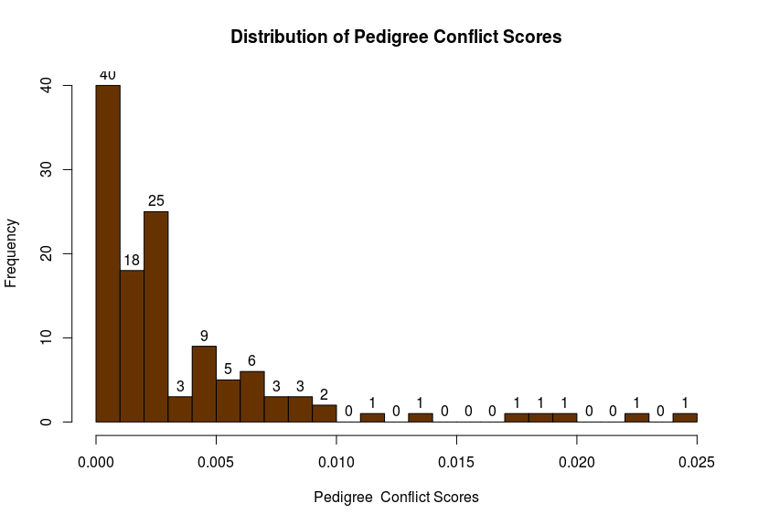
Graph from Pedigree Analysis Tool

Slide 5
Results from Pedigree Analysis Histogram
Cutoff of .010
7 lines that show high degrees of conflict
UG120078 UG110039 UG110039 0.02412680
UG120088 UG110017 UG110017 0.02220224
UG120130 UG110017 UG110017 0.01956481
UG120136 UG110039 UG110039 0.01896954
UG120138 UG110039 UG110039 0.01728277
NR110017 NR010004 NR010004 0.01306488
IITA-TMS-IBA070952 IITA-TMS-IBA011442 IITA-TMS-IBA011442 0.01110748

Slide 6
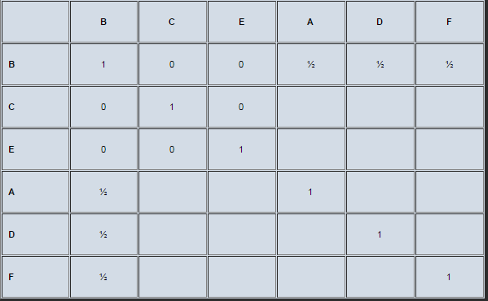
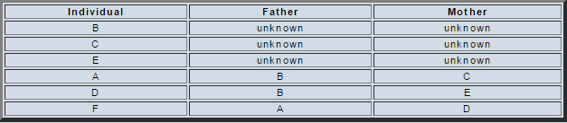
Additive Relationship Matrix
½ for parent-child, 1 for self, 0 for none
Computed using an R package
Informative about expected relationships between accessions

Slide 7
Genetic Marker Distance
Used in determining how far apart accessions are genetically
Score closer to 0 shows a closer genetic relationship
Calculated using Euclidean distance
Numerical analysis only, does not take biological factors (such as mutations) into account
Calculated using an R package

Slide 8
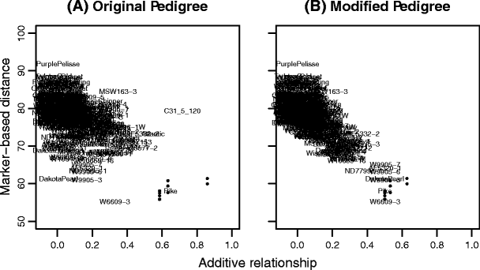
Pedigree Correction
Graph additive relationship vs genetic marker distance on accessions with high pedigree conflict scores
Look for potential parents with low genetic distance and no known relationship (bottom left corner)

Slide 9

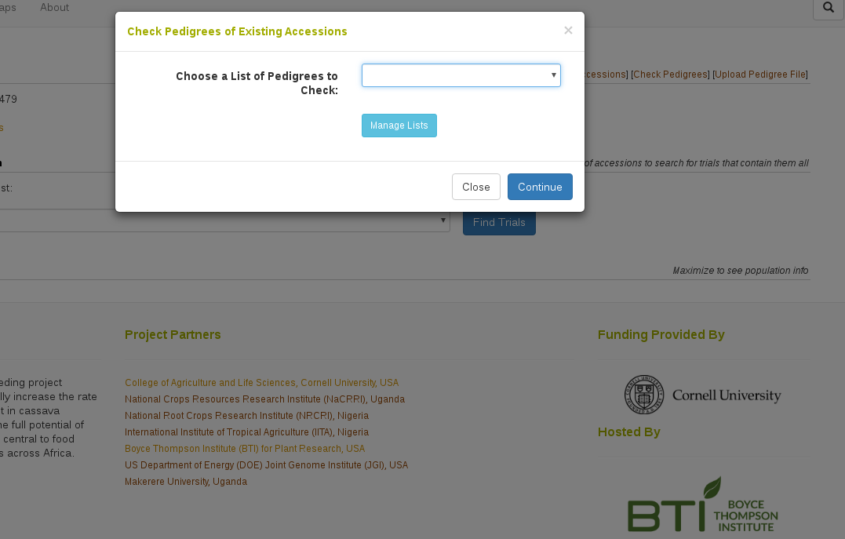
CassavaBase Tool

Slide 10
Next Steps
Finish implementing automatic check upon pedigree upload on CassavaBase and independent tool
Different controls and tests of the program (such as a test of the possibly incorrect father as both parents)
More filters in order to lessen the amount of SNPs being tested
Assignment of correct parents on lines that are suspected to be erraneous

